Slide 1
Name Minal Borhade PRESENTATION TITLE
Automate tripplanner website
Guide:
Rini Simon

Slide 2
AGENDA
Introduction​
Sdlc life cycle
Database Management System
Test automation tools
​

Slide 3
Introduction
Software is a program or set of programs containing instructions that provide desired functionality. And Engineering is the process of designing and building something that serves a particular purpose and finds a cost-effective solution to problems.
Software engineering is the process of designing, developing, testing, and maintaining software. It is a systematic and disciplined approach to software development that aims to create high-quality, reliable, and maintainable software. Software engineering includes a variety of techniques, tools, and methodologies, including requirements analysis, design, testing, and maintenance.

Slide 4
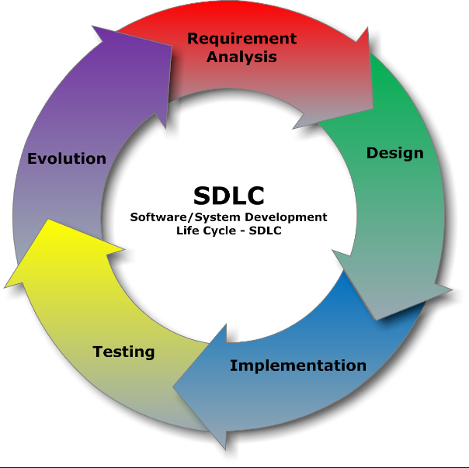
Sdlc lIfe cycle

Slide 5
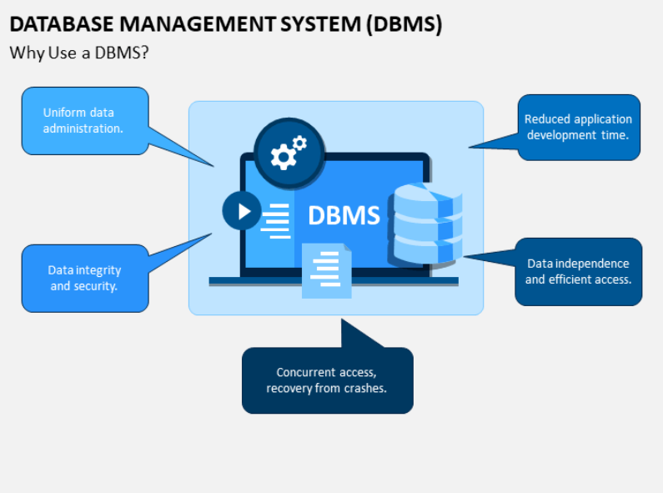
Do I need to do testing?
Everyone who develops software does testing- that’s unavoidable.
Why it matters-The goal is to try as many “critical” input combinations , as possible give the time & resource constraint.
Database management System

Slide 6
Database Management System
Database Management System is a software or Technology used to manage data from a database
Some popular databases are MySQL , Oracle ,MongoDB etc.
DBMS provides many operation. Ex creating database ,Storing in the database , updating & existing database , delete from the database.
DBMS is system that enable you to stored , modify & retrieve data in an organized way
It is also provide security to the database

Slide 7
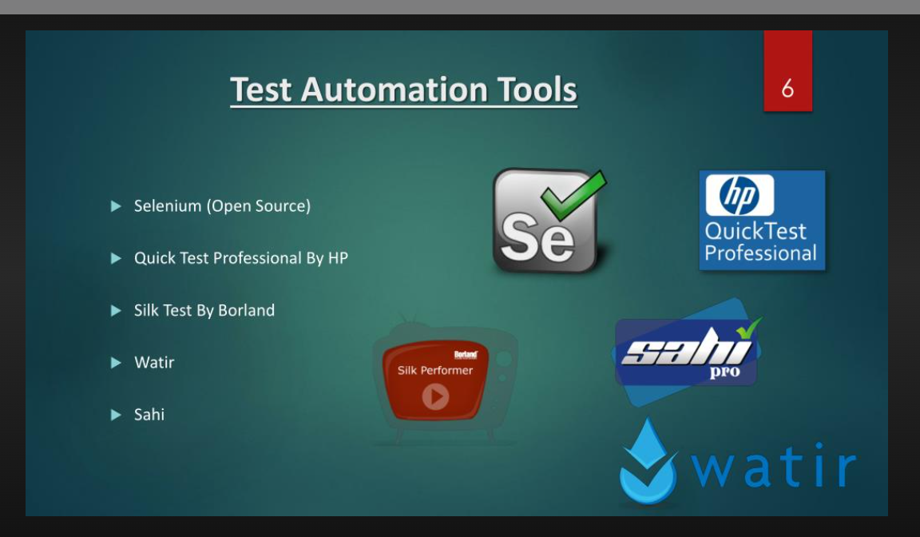
Final project :

Slide 8
Conclusion
Organization have considered selenium for a variety of reasons, including meeting test automation goals
Selenium add in the robustness, cost-effectiveness, speed –up the software testing life cycle.
Result organization should consider as selenium as promising test automation tool foe web application testing.
Selenium is more flexible compared with other testing tool.

Slide 9
THANK YOU

